Slide 1


PhonePe Pulse Data Visualization Project
Presentation
By: Soham Mukherjee
Interactive Tableau Dashboard & Insights

Slide 2
Objective
Visualize India’s digital payment landscape using PhonePe Pulse data.
Analyze trends across states, districts, years, and quarters.
Use Tableau to create interactive geo-visualizations.
Provide business insights for digital payment growth.

Slide 3
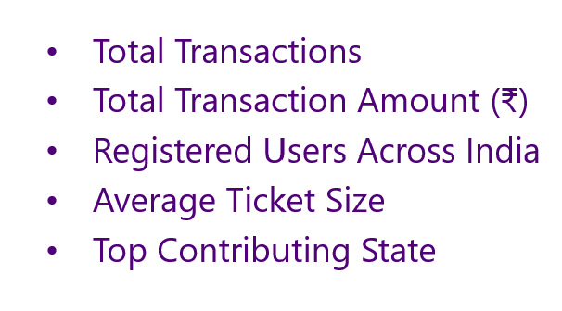
KPI Summary

Slide 4
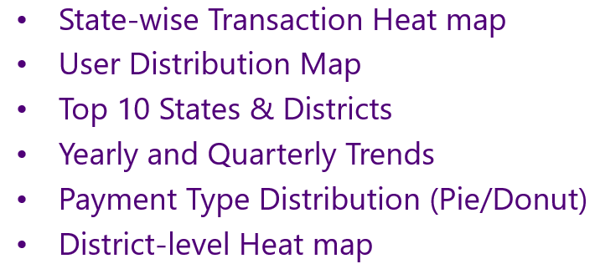
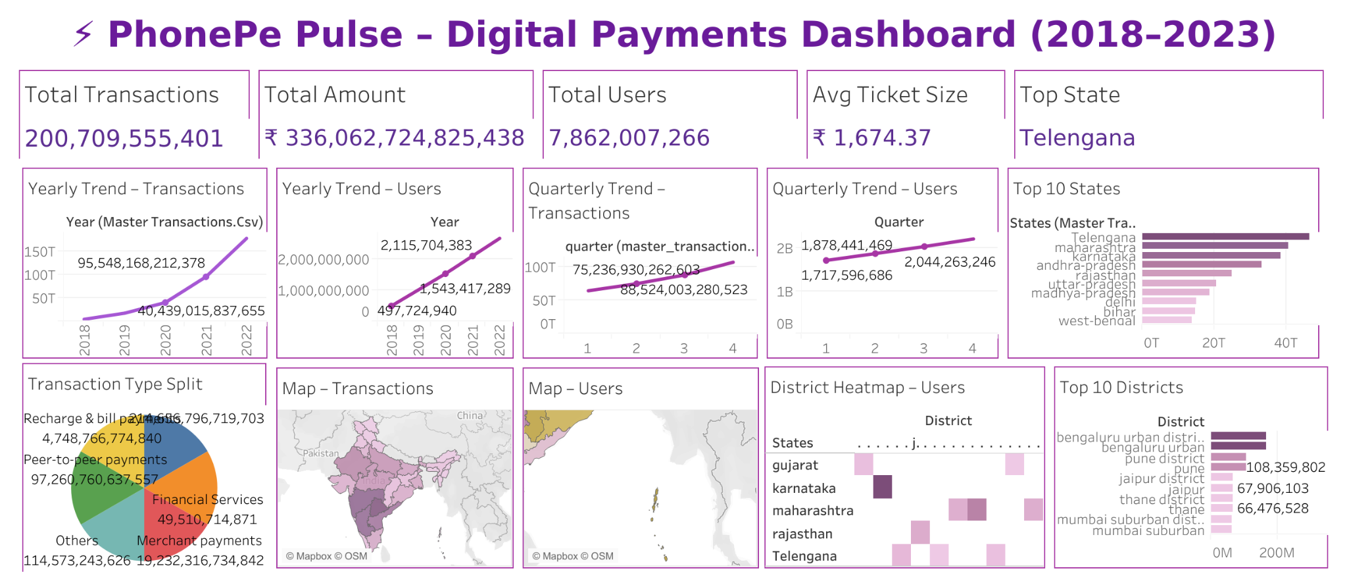
Visualizations Included

Slide 5
Dashboard Link
Interactive Tableau Dashboard:
https://public.tableau.com/shared/D4Q4Y6B2J?:display_count=n&:origin=viz_share_link

Slide 6
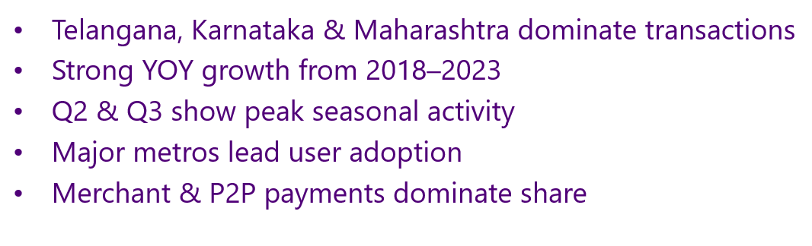
Insights

Slide 7
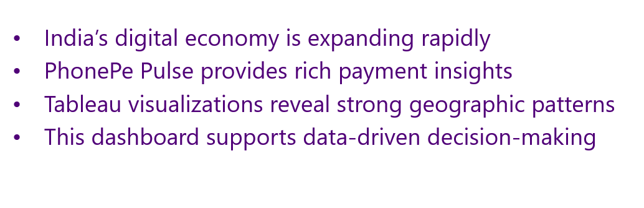
Conclusion

